Slide 1



Magnetic Materials Group
Diamond, SEMINAR
Electron-phonon Coupling and Charge Excitations
in Cuprate Superconductors
Qisi Wang (I21 user)
August 4th 2022

Slide 2
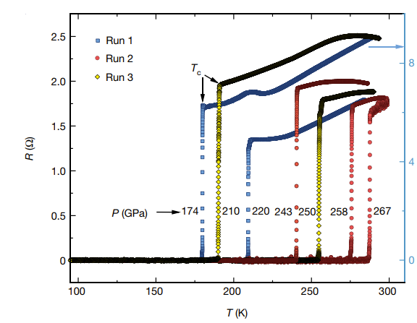
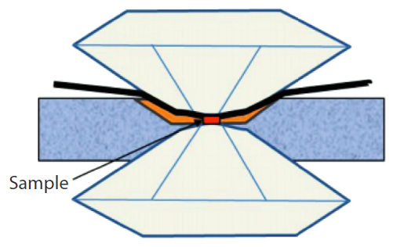
Recent breakthrough
2020: room temperature superconductivity in C-S-H
E. Snider et al., Nature 586, 373 (2020)

Slide 3
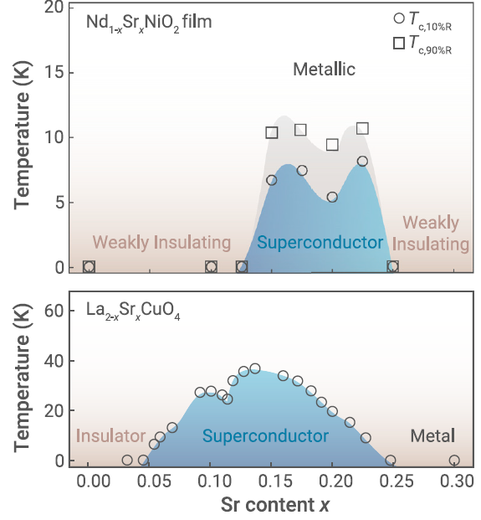
Recent breakthrough
2020: room temperature superconductivity in C-S-H
2019: superconductivity in
infinite-layer nickelates
E. Snider et al., Nature 586, 373 (2020)
D. Li et al., Nature 572, 624 (2019)

Slide 4
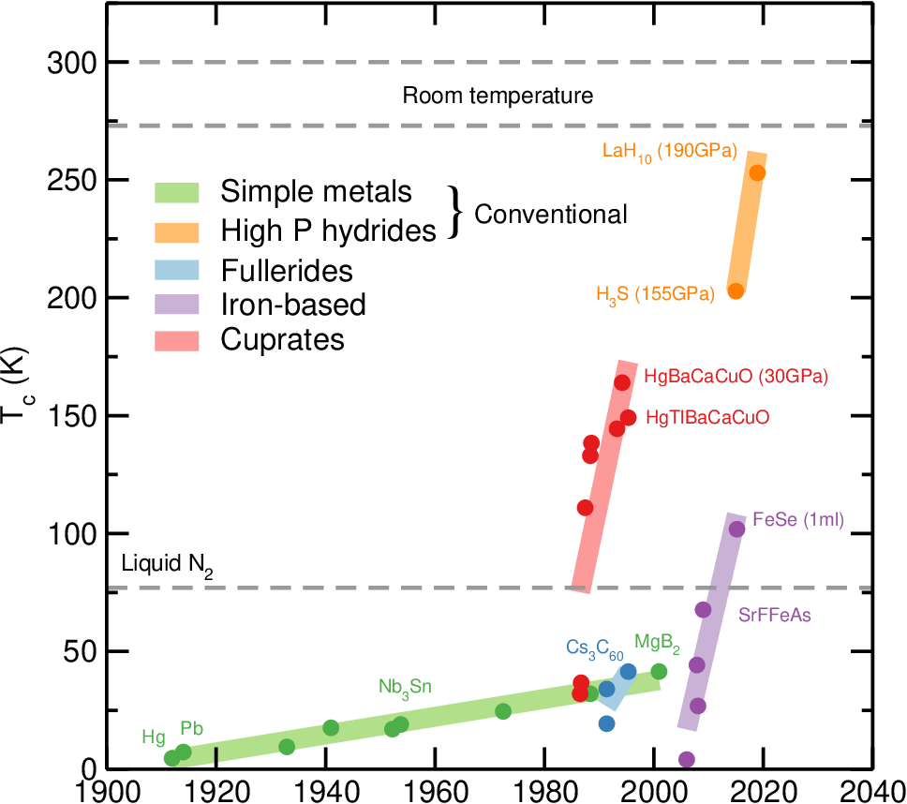
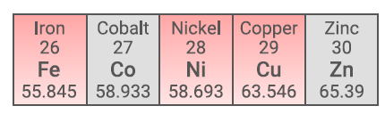
Cuprates – highest T_{c} at ambient pressure
Nickelates
LaSrNiO₂
Pickard et al., Annu. Rev. Condens. Matter Phys. 11, 57 (2020)

Slide 5
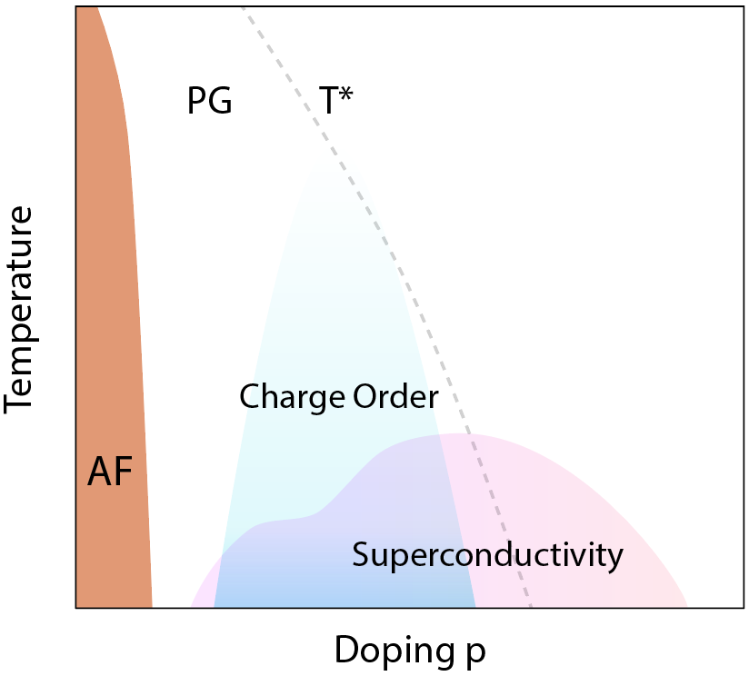
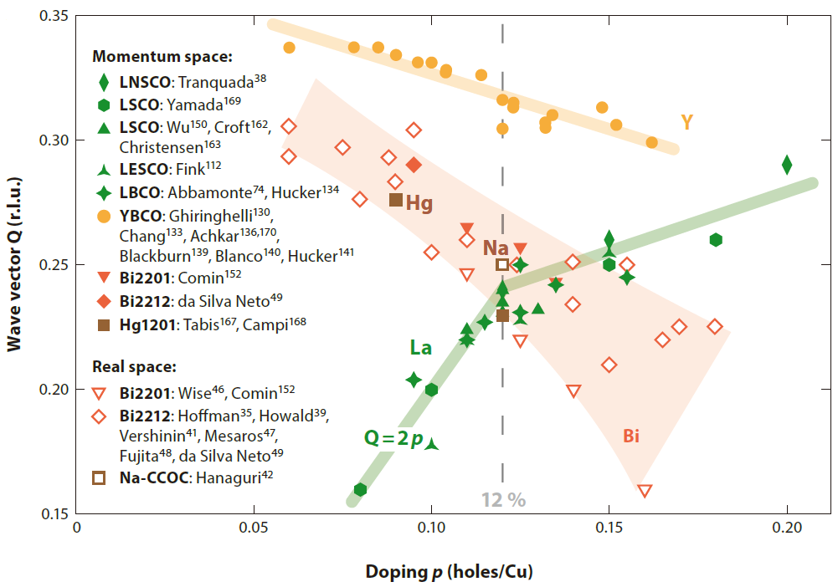
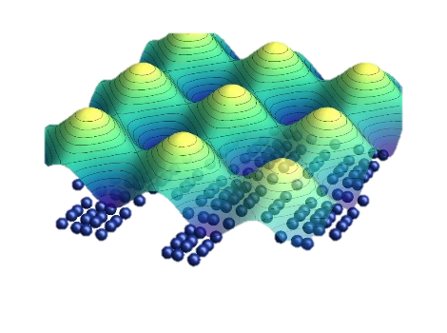
Ubiquitous charge order in hole-doped cuprates
General phase diagram
Charge order in all hole-doped cuprates
R. Comin & A. Damascelli, Annu. Rev. Condens. Matter Phys 7, 369 (2016)

Slide 6
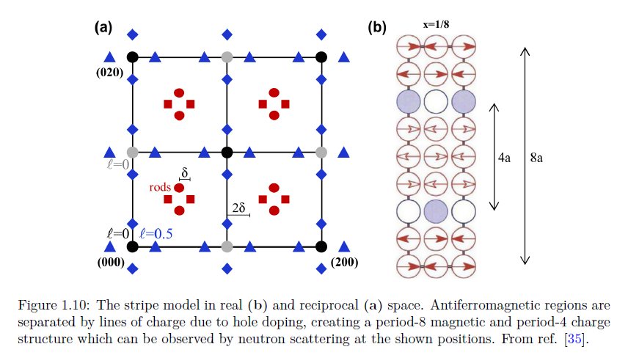
Spin-charge stripe phase in doped Mott insulators
Real space
t
U
J ~ -2t²/U
J. M. Tranquada et al., Nature 375, 561 (1995)

Slide 7
Diffraction evidence of charge-spin stripe
Reciprocal space
Real space
spin
modulation
charge
modulation
δ_{charge}= 2 δ_{spin} ~ ¼
J. M. Tranquada et al., Nature 375, 561 (1995)

Slide 8
Symmetry of charge order: stripe or checkerboard?
Real space
Reciprocal space
R. Comin et al., Science 347, 1335 (2015)

Slide 9
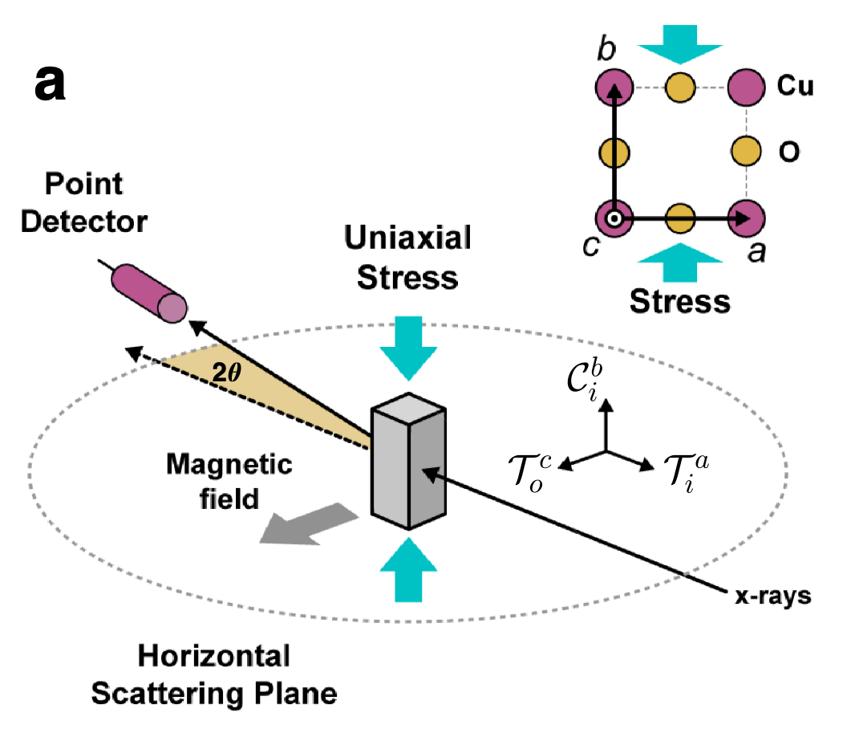
Lifting the charge-stripe domain degeneracy
LSCO
J. Choi, Q. Wang et al., Phy. Rev. Lett. 128, 207002 (2022)

Slide 10
Lifting the charge-stripe domain degeneracy
K
H
J. Choi, Q. Wang et al., Phy. Rev. Lett. 128, 207002 (2022)

Slide 11
Lifting the charge-stripe domain degeneracy
K
H
K
H
J. Choi, Q. Wang et al., Phy. Rev. Lett. 128, 207002 (2022)

Slide 12
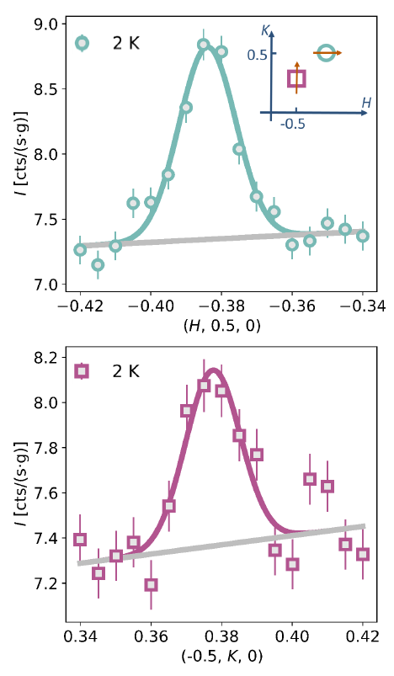
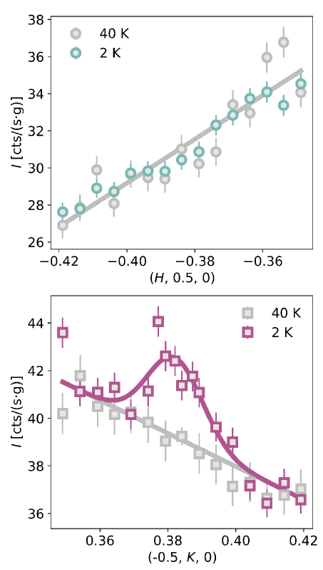
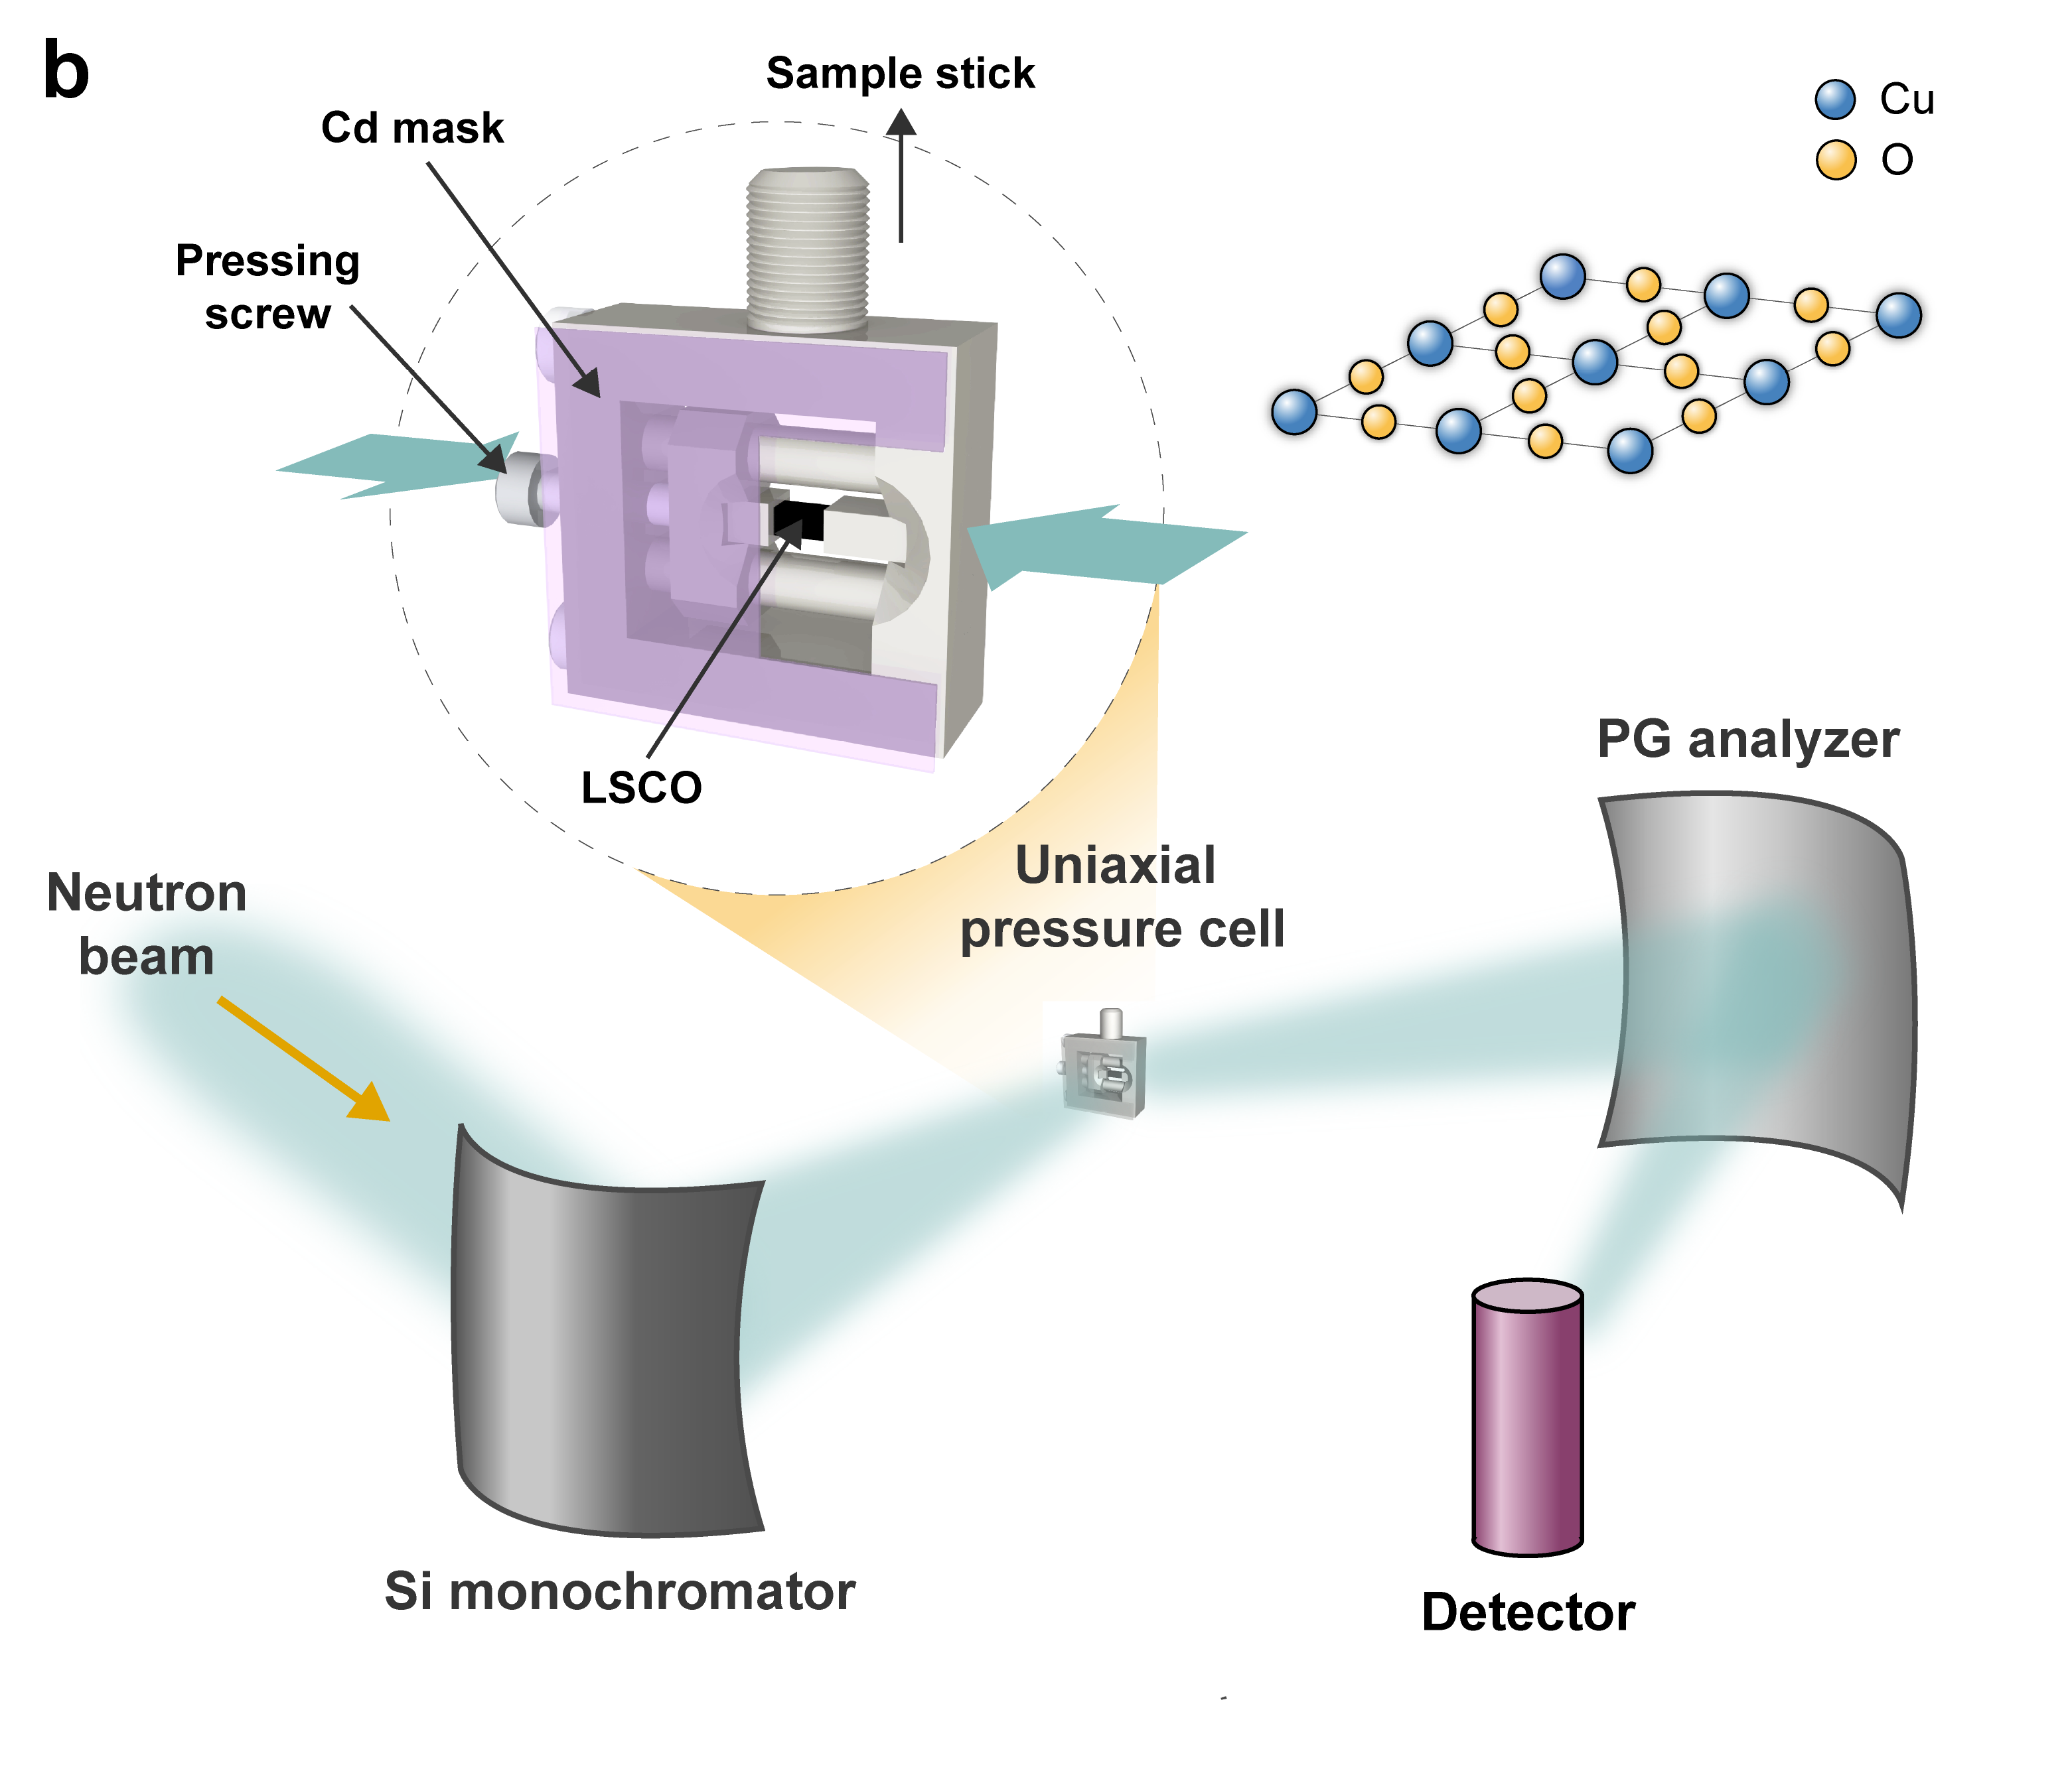
Lifting the spin-stripe domain degeneracy
G. Simutis, J. Küspert, Q. Wang et al., arXiv: 2204.02304

Slide 13
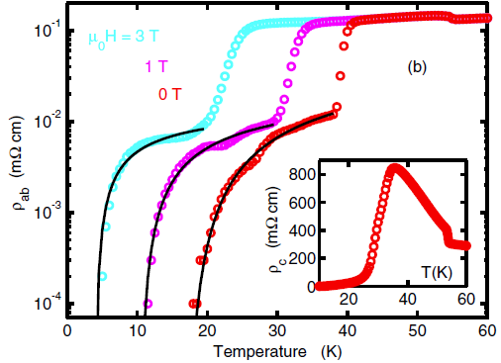
Pair-density-wave (PDW) & charge-density-wave (CDW)
2D SC state & 3D uniform SC
Why is interlayer Josephson coupling frustrated?
Q. Li et al., PRL 99, 067001 (2007)

Slide 14
Pair-density-wave (PDW) & charge-density-wave (CDW)
2D SC state & 3D uniform SC
Real-space schematic of PDW and CDW stripes
Q. Li et al., PRL 99, 067001 (2007)
J. Choi, Q. Wang et al., PRL 128, 207002 (2022)

Slide 15
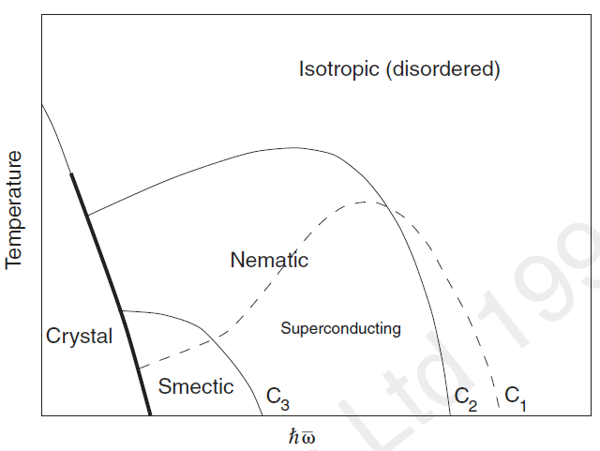
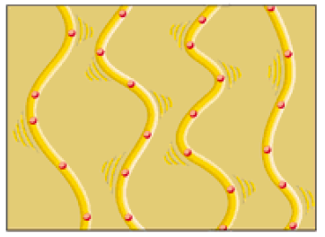
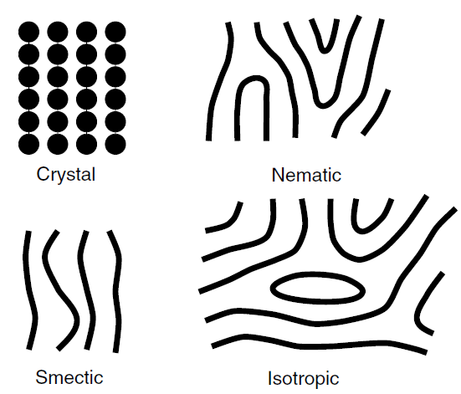
Transverse stripe fluctuation
Transverse stripe fluctuation magnitude
2D electron motion due to stripe fluctuations
S. A. Kivelson et al., Nature 393, 550 (1998)
J. Zaane et al., Science 286, 251(1999)

Slide 16
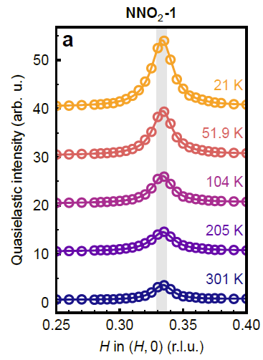
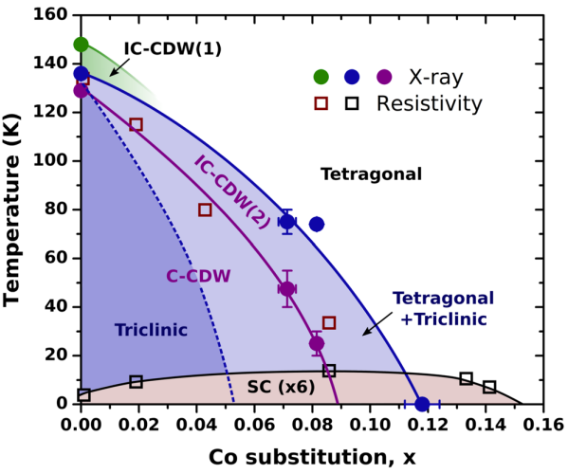
Charge order in nickelates and pnictides systems
Ni112 superconductor
Ba(Ni,Co)₂As₂
M. Rossi et al., Nat. Phys. (2022)
C. Tam, J. Choi, X. Ding, et al., ArXiv: 2112.04440
S. Lee et al., PRL 122, 147601 (2019)
G. Krieger et al., PRL129, 027002 (2022)

Slide 17
Outstanding questions about cuprate charge order
Microscopic mechanism
Is charge order a spontaneous symmetry breaking?
What is the role of the electron-phonon/lattice interaction?
Which phonon mode couples most strongly to charge order

Slide 18
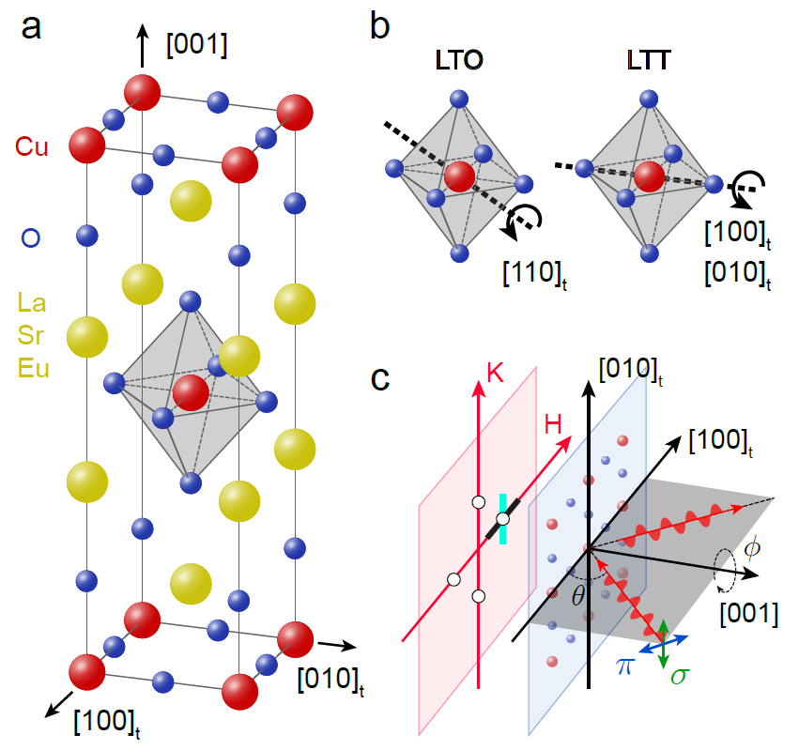
La-214 cuprates
HTT, C₄ symmetry
O
La₂CuO₄
O
Cu
La
Ba/Sr
Q. Wang et al., PRL 124,187002 (2020)

Slide 19
Access to entire phase diagram
HTT, C₄ symmetry
La₂CuO₄
O
Cu
hole p
La
Ba/Sr
La_{2-x} (Sr,Ba)_{x} CuO₄
(LSCO)
(LBCO)
Q. Wang et al., PRL 124,187002 (2020)

Slide 20
Charge order in La-214 cuprates
HTT, C₄ symmetry
La₂CuO₄
O
Cu
hole p
La
Ba/Sr
La_{2-x} (Sr,Ba)_{x} CuO₄
(LSCO)
(LBCO)
Q. Wang et al., PRL 124,187002 (2020)

Slide 21
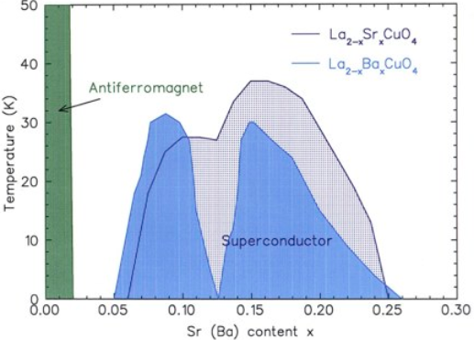
Compound dependent 1/8 T_{c} anomaly
The 1/8 T_{c} anomaly
LSCO
LBCO
J. M. Tranquada, AIP Conf. Proc. 1550, 114 (2013)

Slide 22
LSCO & LBCO: different crystal structure
HTT, C₄ symmetry
HTT
T
T_{HT}
O
Cu
La
Ba/Sr
J. M. Tranquada, AIP Conf. Proc. 1550, 114 (2013)
Q. Wang et al., PRL 124,187002 (2020)

Slide 23
LSCO & LBCO: different crystal structure
C₄ symmetry broken
LTO
HTT
HTT, C₄ symmetry
T
T_{HT}
O
Cu
La
Ba/Sr
LSCO
J. M. Tranquada, AIP Conf. Proc. 1550, 114 (2013)
Q. Wang et al., PRL 124,187002 (2020)

Slide 24
LSCO & LBCO: different crystal structure
C₄ symmetry broken
LTT
LTO
HTT
HTT, C₄ symmetry
T
T_{LT}
T_{HT}
O
Cu
La
Ba/Sr
LSCO
LBCO
J. M. Tranquada, AIP Conf. Proc. 1550, 114 (2013)
Q. Wang et al., PRL 124,187002 (2020)

Slide 25
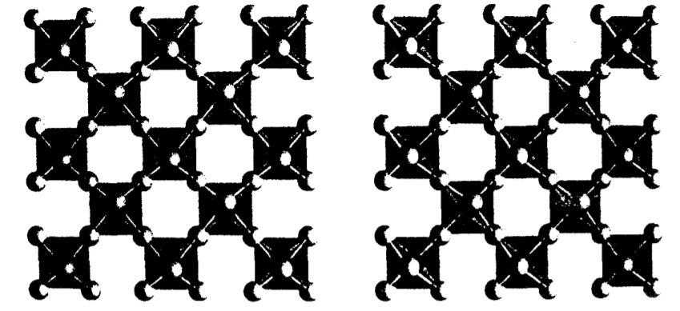
LSCO & LBCO: different crystal structure
C₄ symmetry broken
LTT
LTO
HTT
HTT, C₄ symmetry
T
T_{LT}
T_{HT}
O
Cu
La
Ba/Sr
LSCO
LBCO
LTO
LTT
Stripes
Top view
J. M. Tranquada, AIP Conf. Proc. 1550, 114 (2013)
Q. Wang et al., PRL 124,187002 (2020)

Slide 26
LSCO & LBCO: different crystal structure
C₄ symmetry broken
LTT
LTO
HTT
HTT, C₄ symmetry
T
T_{LT}
T_{HT}
O
Cu
La
Ba/Sr
LSCO
LBCO
LTO
LTT
Stripes
Top view
J. M. Tranquada, AIP Conf. Proc. 1550, 114 (2013)
Q. Wang et al., PRL 124,187002 (2020)

Slide 27
LSCO & LBCO: different crystal structure
HTT, C₄ symmetry
La₂CuO₄
O
Cu
hole
Isovalent
La
Eu/Nd
Ba/Sr
La_{2-x-y} (Nd,Eu)_{y} (Sr)_{x} CuO₄
(Eu-LSCO)
(Nd-LSCO)
Q. Wang et al., PRL 124,187002 (2020)

Slide 28
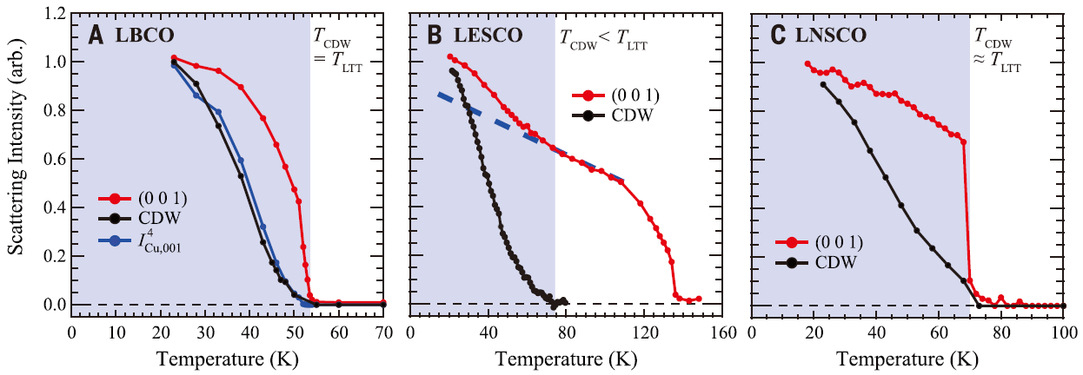
LTT & charge order
Resonant elastic x-ray scattering (REXS) results
LBCO
Eu-LSCO
Nd-LSCO
Tco <= T_{LTT}
Charge order is driven by the LTT phase?
LTT grows faster than charge order
A. Achkar et al., Science 351, 576 (2016)

Slide 29
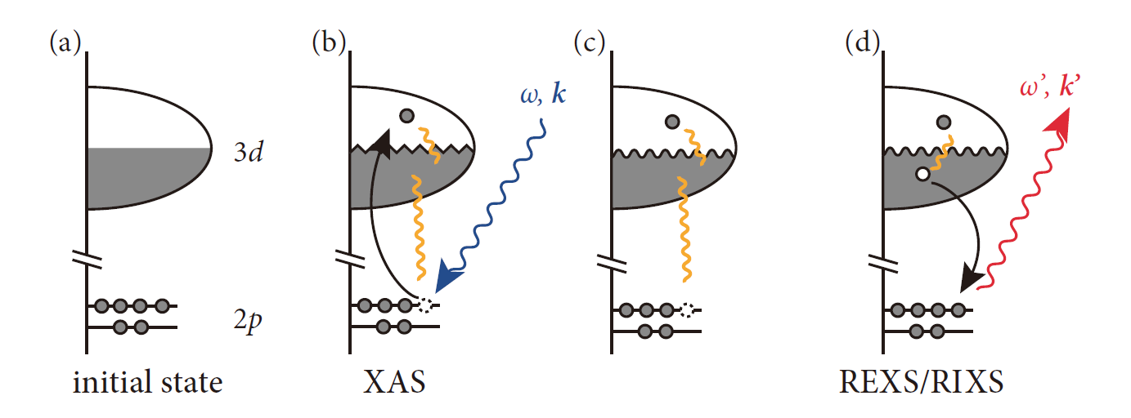
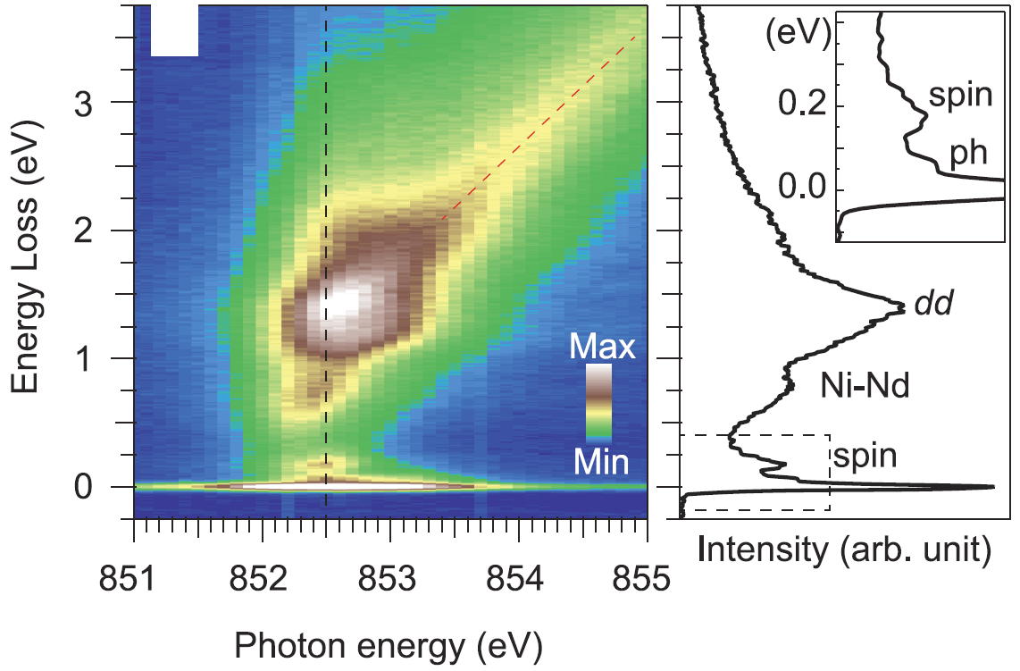
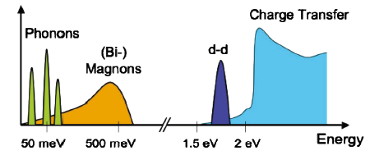
Resonant inelastic x-ray scattering (RIXS)
Excitations in infinite-layer nickelates
at Ni L-resonance
XAS (absorption) & RIXS process
Excitation probed by RIXS
Sensitive to electronic correlations: charge, spin…
Polarization selections: spin flip/non-flip
Resolve energy and momentum
L. J. P. Ament et al., Rev. Mod. Phys. 83, 705 (2011)
H. Lu et al., Science 383, 213 (2021)

Slide 30
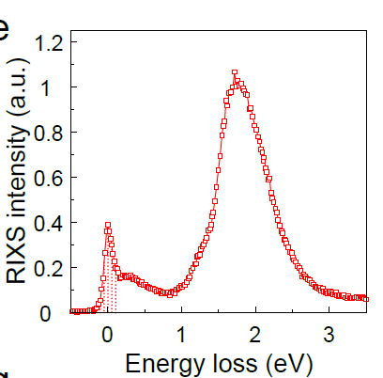
RIXS for diffraction
Raw RIXS spectrum
Excitations in infinite-layer nickelates
at Ni L-resonance
dd
elastic
magnon
Compared to REXS: inelastic process are filtered
-- lower background
Q. Wang et al., PRL 124,187002 (2020)
H. Lu et al., Science 383, 213 (2021)

Slide 31
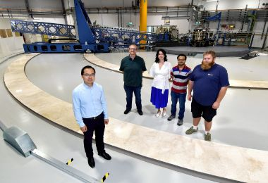
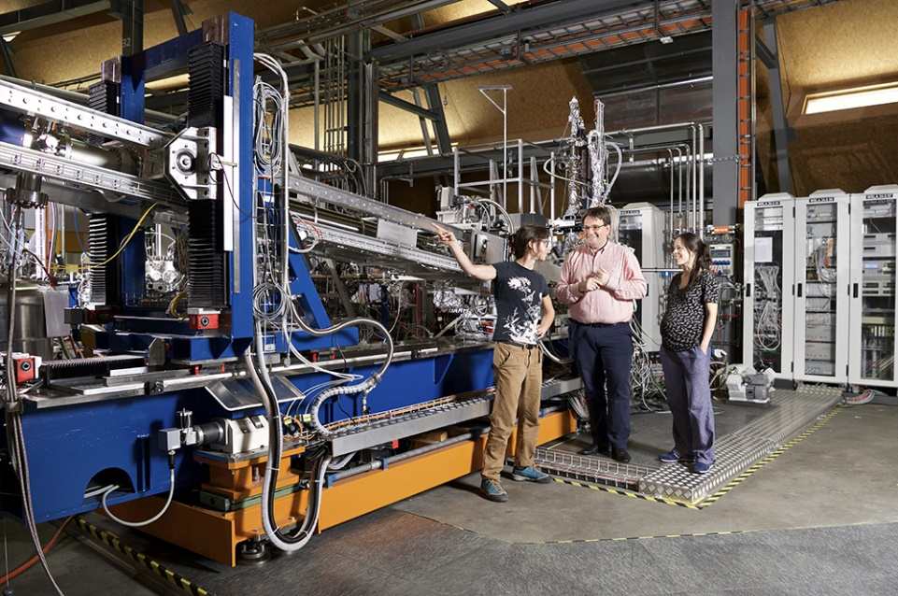
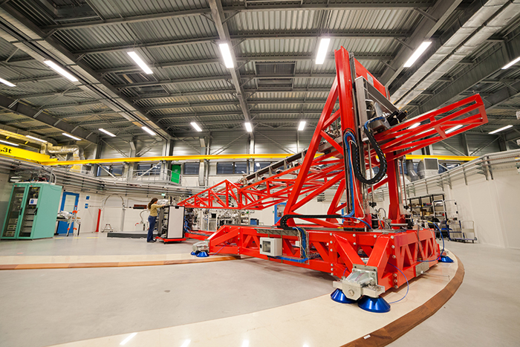
RIXS beamlines
I21, Diamond Light Source, UK
ADRESS, Swiss Light Source, Switzerland
ID32, Eur. Synchrotron Rad. Facility, France

Slide 32
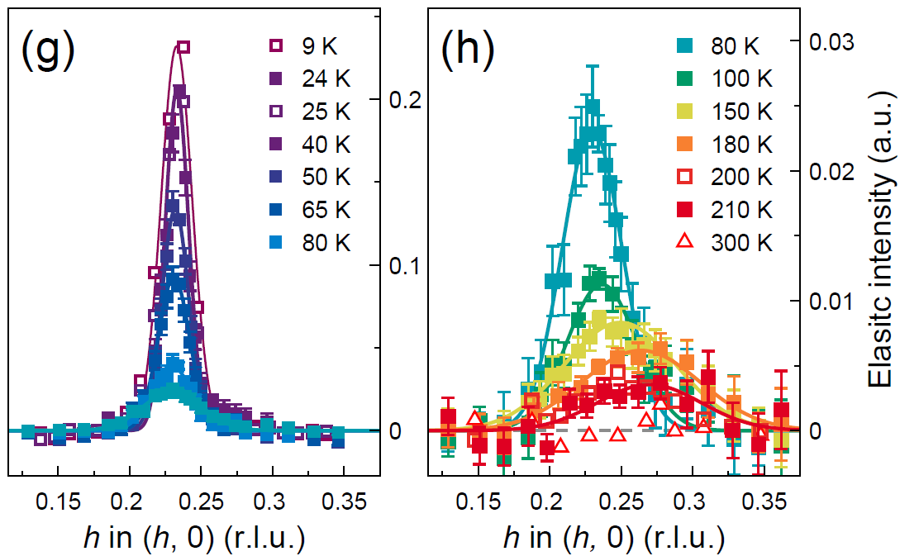
Temperature evolution of charge order in Eu-LSCO
H-scan of elastic scattering
k
T_{LTT} = 125 K
h
Q. Wang et al., PRL 124,187002 (2020)

Slide 33
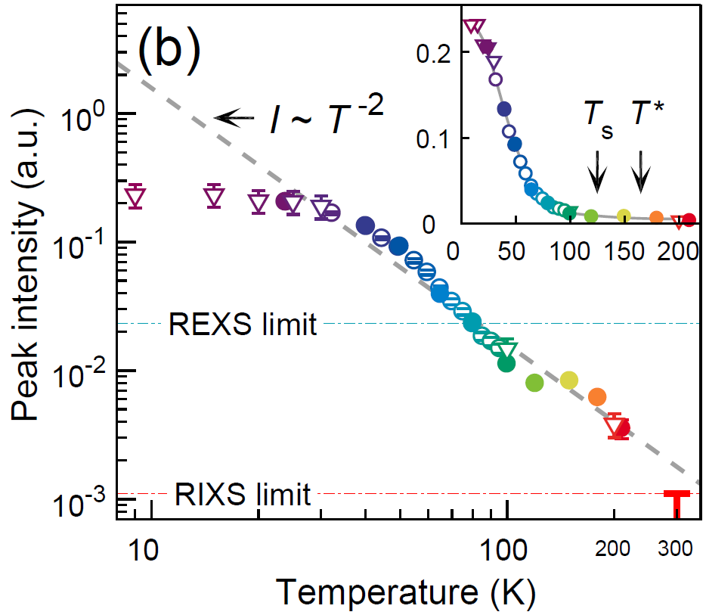
No clear onset for charge order detected
Peak intensity I vs T
Charge correlations outside LTT:
Spontaneous symmetry breaking
No clear onset
REXS-defined onset: probing limit
RIXS-probing limit between 200~300 K
Q. Wang et al., PRL 124,187002 (2020)

Slide 34
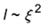
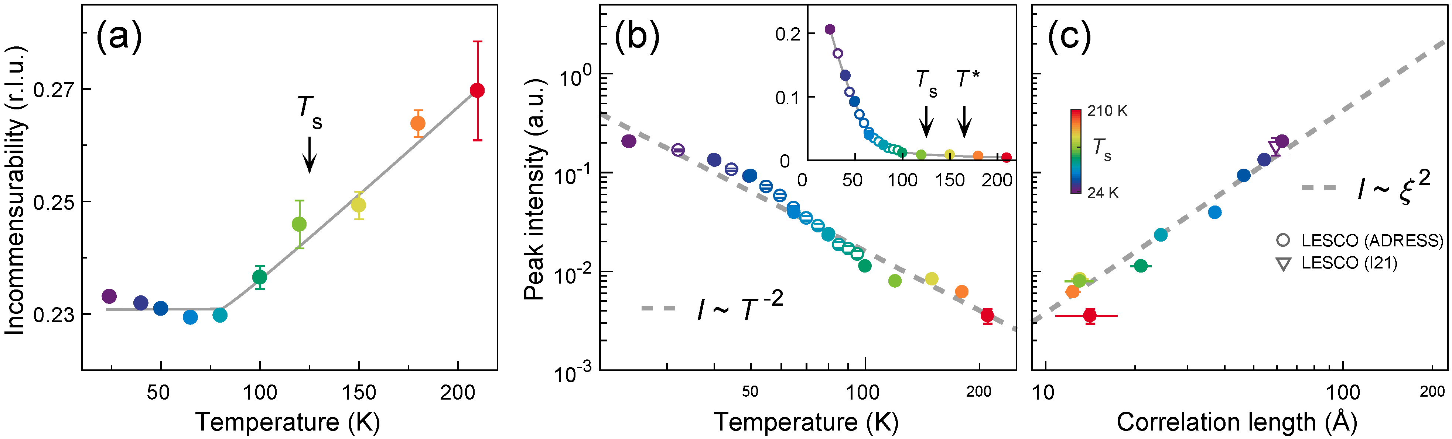
intensity and correlation length scaling
Peak intensity vs correlation length
Scaling behavior:
constant scattering volume
Q. Wang et al., PRL 124,187002 (2020)

Slide 35
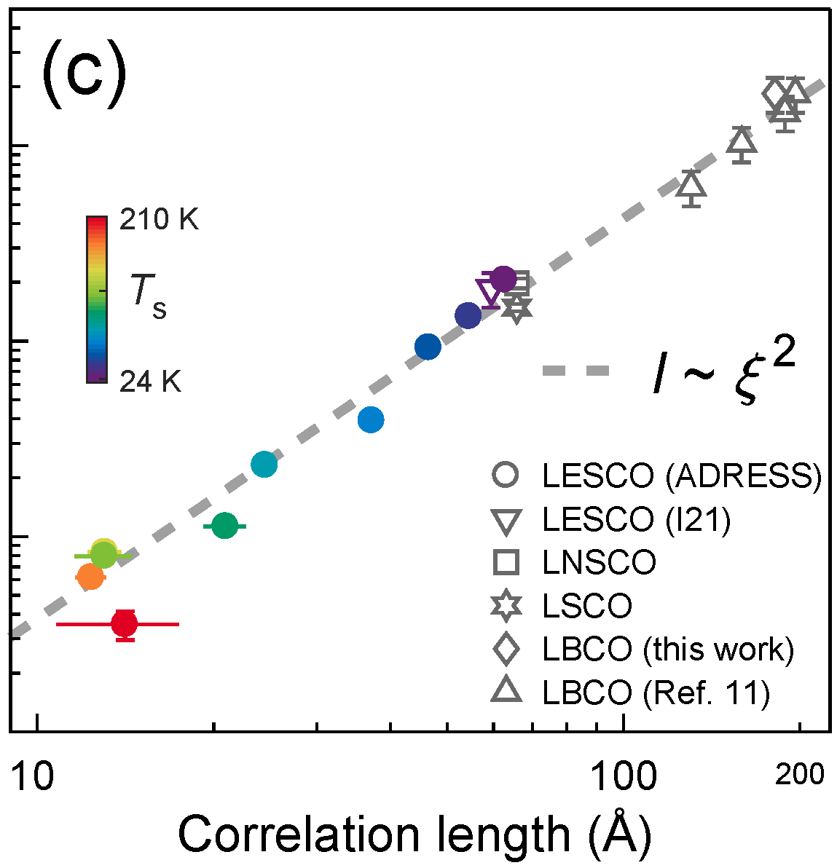
intensity and correlation length scaling
Peak intensity vs correlation length
Scaling behavior:
constant scattering volume
Q. Wang et al., PRL 124,187002 (2020)

Slide 36
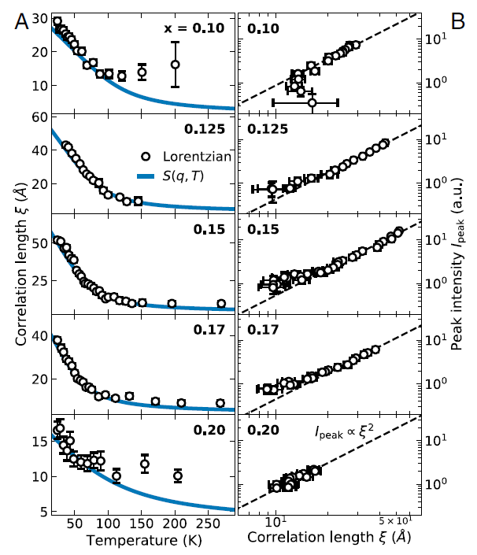
Generic scaling behavior of charge order
New REXS results with more carefully background analysis
Lee et al., 119, PNAS e2119429119 (2022)

Slide 37
Outstanding questions about cuprate charge order
Microscopic mechanism
Is charge order a spontaneous symmetry breaking?
What is the role of the electron-phonon/lattice interaction?
Which phonon mode couples most strongly to charge order

Slide 38
Spin-charge stripe phase in doped Mott insulators
Real space
t
U
J ~ -2t²/U
J. M. Tranquada et al., Nature 375, 561 (1995)

Slide 39
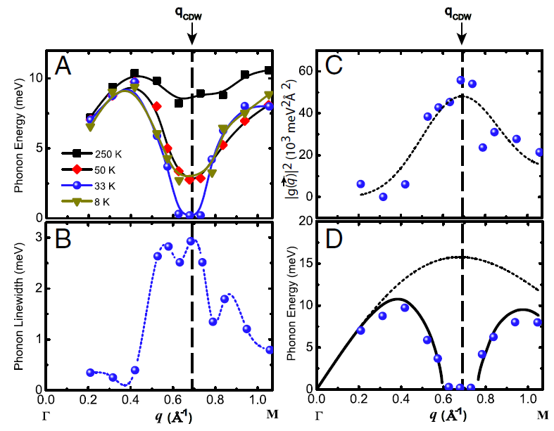
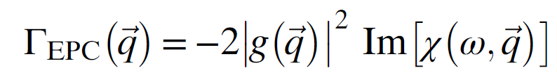
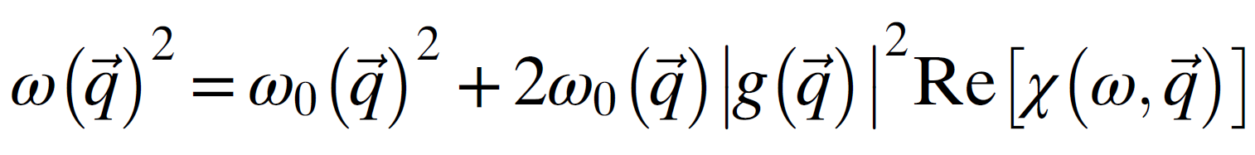
Charge order due to electron-phonon coupling
CDW due to Q-dependent EPC
(Electron-phonon coupling)
NbSe₂
Weber et al., PRL 2011
X. Zhu et al., PNAS 112, 2367 (2015)

Slide 40
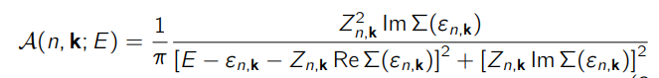
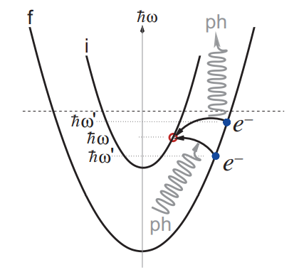
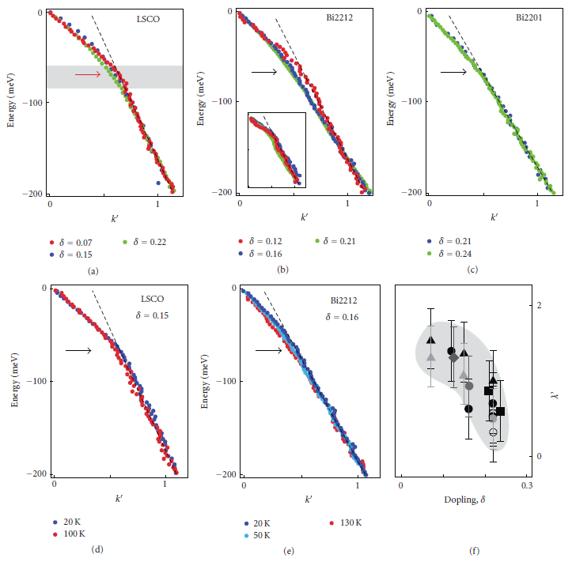
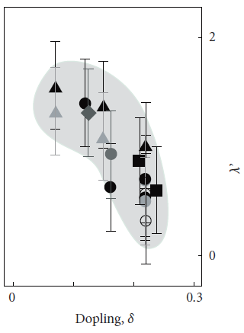
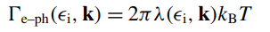
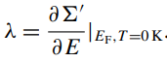
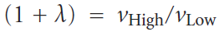
ARPES as a probe of e-ph coupling
Inter-band e-ph
scattering
ARPES kink
EPC constant
Hofmann et al., New J. Phys. 11, 125005 (2009)
Lanzara et al., Nature, 412, 510 (2001)

Slide 41
ARPES as a probe of e-ph coupling
Inter-band e-ph
scattering
ARPES kink
EPC constant
Which bosonic mode? Phonon? Magnon?
Which phonon?
Hofmann et al., New J. Phys. 11, 125005 (2009)
Lanzara et al., Nature, 412, 510 (2001)
q-dependence of M(k,q)?

Slide 42
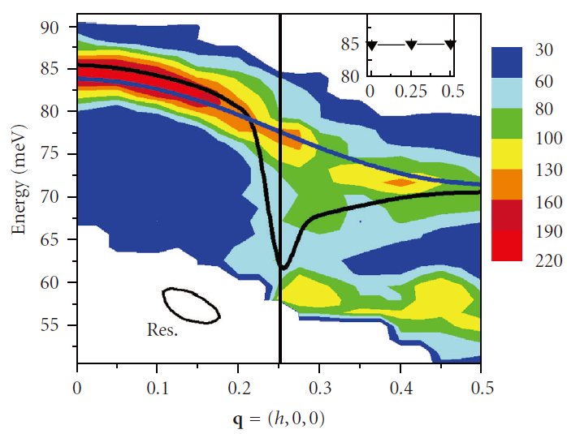
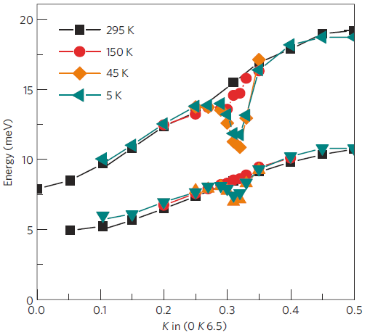
Soft phonon in cuprates
LBCO-1/8
Underdoped YBa₂Cu₃O_{6.6}
D. Reznik et al., Nature 440, 1170 (2006)
M. Le Tacon et al., Nature Physics 10, 52 (2013).

Slide 43
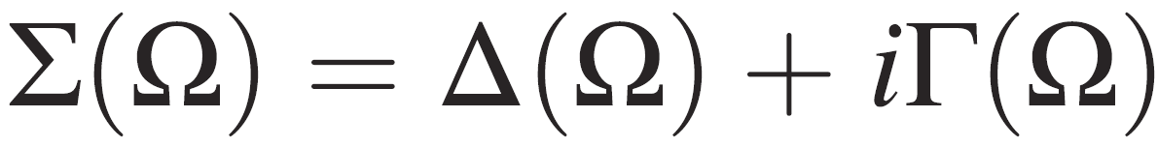
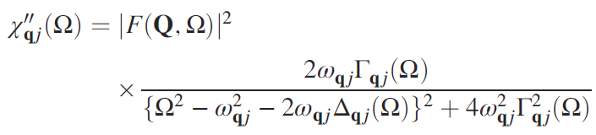
Soft phonon in cuprates
LBCO-1/8
Underdoped YBa₂Cu₃O_{6.6}
D. Reznik et al., Nature 440, 1170 (2006)
M. Le Tacon et al., Nature Physics 10, 52 (2013).
Phonon self-energy

Slide 44


RIXS process to generate phonons
L. Braicovich et al., PRR 2, 023231 (2020)

Slide 45
RIXS process to generate phonons
RIXS phonon intensity
i) Electron-phonon coupling
ii) Core-hole life-time
L. Braicovich et al., PRR 2, 023231 (2020)

Slide 46



Anomalous cuprate phonons probed by RIXS
Bi2212
Bi2201
LSCO
W. S. Lee, K.-J. Zhou et al., Nat. Phys. 17, 53 (2021)
J. Li et al., PNAS 117, 16219 (2020)
J. Q. Lin et al., PRL124, 207005 (2020)
Cuprate phonon studies enabled by the ultrahigh resolution at I21

Slide 47


I21: ultrahigh resolution RIXS beamline
I21, Diamond Light Source, UK

Slide 48

Low-energy excitation mode at ~ 60 meV
Cu L-edge
Q. Wang et al., Sci. Adv. 7, eabg7394 (2021)

Slide 49


Assignment: bond stretching (BS) phonon mode
Cu L-edge
BS phonon eigenvector
at Q = (0.25,0)
O
Cu
Q. Wang et al., Sci. Adv. 7, eabg7394 (2021)

Slide 50


Phonon lifetime shortening near Q_{CDW}
Q. Wang et al., Sci. Adv. 7, eabg7394 (2021)

Slide 51

BS phonon softening
BS phonon anomaly
Softening around Q_{CDW}
At high T due to charge correlations
Q. Wang et al., Sci. Adv. 7, eabg7394 (2021)

Slide 52
Anomalous BS phonon intensity
BS phonon anomaly
Softening around Q_{CDW}
At high T due to charge correlations
Enhanced e-phonon coupling at low T
Q. Wang et al., Sci. Adv. 7, eabg7394 (2021)

Slide 53
Anomalous BS phonon intensity
BS phonon anomaly
Softening around Q_{CDW}
At high T due to charge correlations
Enhanced e-phonon coupling at low T
Occurs within the LTT phase
Q. Wang et al., Sci. Adv. 7, eabg7394 (2021)

Slide 54

Anomalous BS phonon intensity
Q. Wang et al., Sci. Adv. 7, eabg7394 (2021)

Slide 55

Outstanding questions about cuprate charge order
Microscopic mechanism
Is charge order a spontaneous symmetry breaking?
What is the role of the electron-phonon/lattice interaction?
EPC contributes significantly in addition to the electronic correlations
to the long-range charge order formation.
Q. Wang et al., Science Advances 7, eabg7394 (2021).

Slide 56
Outstanding questions about cuprate charge order
Microscopic mechanism
Is charge order a spontaneous symmetry breaking?
What is the role of the electron-phonon/lattice interaction?
Which phonon mode couples most strongly to charge order

Slide 57


EPC through lower-lying phonons?
Why lower-energy phonons
Low-energy phonons may also couple strongly to charge order
Bond-
stretching
Apical
Buckling
Giustino et al., Nature 452, 975 (2008)
Anazai Sci. Rep. (2017)

Slide 58

EPC through lower-lying phonons?
Why lower-energy phonons
Low-energy phonons may also couple strongly to charge order
Bond-
stretching
Low-energy phonons could possibly influence pairing
Apical
Buckling
Giustino et al., Nature 452, 975 (2008)
Anazai Sci. Rep. (2017)
Johnston PRB 82, 064513 (2010)

Slide 59

EPC through lower-lying phonons?
Why lower-energy phonons
Low-energy phonons may also couple strongly to charge order
Bond-
stretching
Low-energy phonons could possibly influence pairing
Why O K-edge RIXS
Bands across the Fermi level have significant O 2p_{x,y} character
Apical
Buckling
LSCO XAS
Giustino et al., Nature 452, 975 (2008)
Anazai Sci. Rep. (2017)
Johnston PRB 82, 064513 (2010)
Chen PRL 66, 104 (1991)

Slide 60
EPC through lower-lying phonons?
Why lower-energy phonons
Low-energy phonons may also couple strongly to charge order
Bond-
stretching
Low-energy phonons could possibly influence pairing
Why O K-edge RIXS
Bands across the Fermi level have significant O 2p_{x,y} character
Apical
Higher energy resolution
Buckling
LSCO XAS
Giustino et al., Nature 452, 975 (2008)
Anazai Sci. Rep. (2017)
Johnston PRB 82, 064513 (2010)
Chen PRL 66, 104 (1991)

Slide 61
EPC through lower-lying phonons?
Why lower-energy phonons
Low-energy phonons may also couple strongly to charge order
Bond-
stretching
Low-energy phonons could possibly influence pairing
Why O K-edge RIXS
Bands across the Fermi level have significant O 2p_{x,y} character
Apical
Higher energy resolution
Longer core-hole lifetime — larger RIXS phonon cross sections
Buckling
LSCO XAS
Giustino et al., Nature 452, 975 (2008)
Anazai Sci. Rep. (2017)
Johnston PRB 82, 064513 (2010)
Chen PRL 66, 104 (1991)

Slide 62
EPC through lower-lying phonons?
Why lower-energy phonons
Low-energy phonons may also couple strongly to charge order
Bond-
stretching
Low-energy phonons could possibly influence pairing
Why O K-edge RIXS
Bands across the Fermi level have significant O 2p_{x,y} character
Apical
Higher energy resolution
Longer core-hole lifetime — larger RIXS phonon cross sections
Buckling
Single magnon disallowed — phonons are more isolated
LSCO XAS
Giustino et al., Nature 452, 975 (2008)
Anazai Sci. Rep. (2017)
Johnston PRB 82, 064513 (2010)
Chen PRL 66, 104 (1991)

Slide 63
I21: ultrahigh resolution RIXS beamline
I21, Diamond Light Source, UK

Slide 64
XAS: significant O p_{xy} orbital character
Grazing-in XAS
LV (E//ab)
3d⁹L->1s3d⁹
LH (E//c)
ZRS
3d⁹->1s3d¹⁰
p_{x,y}
UHB
p_{z}
Resonance at the Zhang-Rice singlet energy

Slide 65

Fitting and assignment of RIXS excitations
Elastic line
dd-excitations
Intensity (a.u.)
phonons
Bi-magnon
-0.5
0
0.5
1
1.5
2
2.5
3
Energy loss (eV)

Slide 66



Fitting and assignment of RIXS excitations
Elastic line
Cu L-edge
O K-edge
dd-excitations
h = 0.18
h = 0.27
Intensity (a.u.)
phonons
Bi-magnon
-0.5
0
0.5
1
1.5
2
2.5
3
Energy loss (eV)

Slide 67




Fitting and assignment of RIXS excitations
Elastic line
Cu L-edge
O K-edge
dd-excitations
h = 0.18
h = 0.27
Intensity (a.u.)
phonons
Bi-magnon
-0.5
0
0.5
1
1.5
2
2.5
3
Energy loss (eV)
Optical
DFT
Bond stretching (half breathing)
Excitation energy
Chaplot et al., PRB 52, 7230 (1995)
Giustino et al., Nature 452, 975 (2008)

Slide 68
Fitting and assignment of RIXS excitations
Elastic line
Cu L-edge
O K-edge
dd-excitations
h = 0.18
h = 0.27
Intensity (a.u.)
phonons
Bi-magnon
-0.5
0
0.5
1
1.5
2
2.5
3
Energy loss (eV)
Optical
DFT
Buckling A1g
Bond stretching (half breathing)
Excitation energy
Chaplot et al., PRB 52, 7230 (1995)
Giustino et al., Nature 452, 975 (2008)

Slide 69
Fitting and assignment of RIXS excitations
Elastic line
Cu L-edge
O K-edge
dd-excitations
h = 0.18
h = 0.27
Intensity (a.u.)
phonons
Bi-magnon
-0.5
0
0.5
1
1.5
2
2.5
3
Energy loss (eV)
Optical
DFT
Buckling A1g
Bond stretching (half breathing)
Buckling B1g
Excitation energy
Chaplot et al., PRB 52, 7230 (1995)
Giustino et al., Nature 452, 975 (2008)

Slide 70
Fitting and assignment of RIXS excitations
Elastic line
Cu L-edge
O K-edge
dd-excitations
h = 0.18
h = 0.27
Intensity (a.u.)
phonons
Bi-magnon
-0.5
0
0.5
1
1.5
2
2.5
3
Energy loss (eV)
Optical
DFT
Buckling A1g
Bond stretching (half breathing)
Buckling B1g
Acoustic mode?
Excitation energy
Chaplot et al., PRB 52, 7230 (1995)
Giustino et al., Nature 452, 975 (2008)

Slide 71
Phonon dispersion and intensity in Eu-LSCO
T_{LTT} = 125 K
T
Q. Wang, X. Hong et al., in preparation

Slide 72
Phonon dispersion and intensity in Eu-LSCO
T_{LTT} = 125 K
T
T_{LTT} = 125 K
T
~20 meV mode
Buckling
mode
Stretching mode
Bond-stretching mode does not peak at Q_{CDW}
20 meV and buckling modes exhibit much sharper peak at Q_{CDW}, which do not correlate with LTT transition
No softening resolved for the 20 meV and buckling modes
Q. Wang, X. Hong et al., in preparation

Slide 73



Phonon dispersion and intensity in Eu-LSCO
~20 meV mode
Stretching mode
Q. Wang, X. Hong et al., in preparation
Xunyang Hong, ETH & UZH

Slide 74



Phonon dispersion and intensity in LSCO
Optimally doped LSCO
Huang et al., PRX 11, 041038 (2021)

Slide 75

Difference between LSCO and Eu-LSCO
Optimally doped LSCO
1/8 doped Eu-LSCO
LSCO?
Eu-LSCO?
W. S. Lee, K.-J. Zhou et al., Nat. Phys. 17, 53 (2021)
Huang et al., PRX 11, 041038 (2021)
Q. Wang, X. Hong et al., in preparation

Slide 76

Summary
Microscopic mechanism
Charge order heralds a spontaneous symmetry breaking
Q. Wang et al., Physical Review Letters 124, 187002 (2020)
Electron-phonon interaction promote the charge order development
Q. Wang et al., Science Advances 7, eabg7394 (2021)
EPC most strongly affects the bond-stretching phonon in Eu-LSCO
Sharp enhancement of the ~20 meV phonon mode can be captured by Fermi surface nesting
Q. Wang, X. Hong et al., in preparation

Slide 77













Acknowledgement
The European Sychrotron
Wenliang Zhang
Thorsten Schmitt
Karin von Arx
Xungyang Hong
Masafumi Horio
Oleh Ivashko
Christian Matt
Johan Chang
Jaewon Choi
Abhishek Nag
Mirian Garcia-Fernandez
Stefano Agrestini
Ke-Jin Zhou
Kurt Kummer
Nick B. Brooks
Tohru Kurosawa
Naoki Momono
Migaku Oda
Henrik M. Rønnow
Deepak Mukkattukavil
Yasmine Sassa
Yao Shen
Jun Zhao
Sunseng Pyon
Tomohiro Takayama
Hidenori Takagi
Sophia University
Yoji Koike
S. M. Haidar
Niels Bech Chirstensen
Tadashi Adachi

